Slide 1
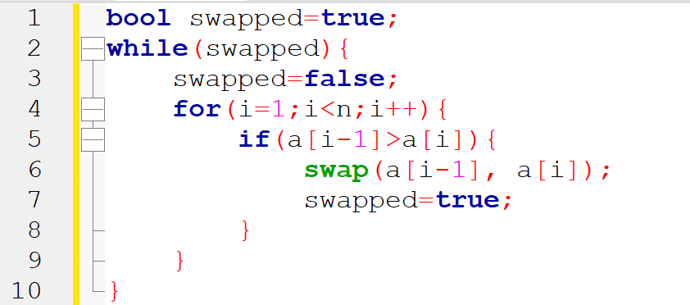
Index(i) | 0 | 1 | 2 | 3 | 4 | 5 | 6 | a
Value a[i] | 12 | 16 | 84 | 42 | 77 | 26 | 53
Line 1: swapped= true
Line 2: While(true) = (line 3 to line 10)
Line 3: swapped = false
Line 4: for(i=1;i<7;i++) ; i=1
Line 5: if( a[i-1] > a[i]) if( a[0]>a[1]) if (12> 16) -- false
Line 4: for(i=1;i<7;i++) ; i=2
Line 5: if(a[i-1] > a[i]) if(a[1] > a[2]) if(16 > 84) ---false

Slide 2
Index(i) | 0 | 1 | 2 | 3 | 4 | 5 | 6 | a
Value a[i] | 12 | 16 | 42 | 77 | 84 | 26 | 53
Line 1: swapped= true
Line 2: While(true) = (line 3 to line 10)
Line 3: swapped = false
Line 4: for(i=1;i<7;i++) ; i=3
Line 5: if(a[2] > a[3]) if(84> 42) -- true
Line 6: swap ( a[2], a[3])
Line 7 : swapped = true
Line 4: for(i=1;i<7;i++) ; i=4
Line 5: if( a[3] > a[4]) if (84 > 77) -- true
Line 6: swap ( a[3], a[4])
Line 7: swapped= true

Slide 3
Index(i) | 0 | 1 | 2 | 3 | 4 | 5 | 6 | a
Value a[i] | 12 | 16 | 42 | 77 | 84 | 100 | 101

